Slide 1
Home work 0

Slide 2
1. Continuous-Time Sinusoidal Generation.
Consider a finite-duration sine that is on from 0 sec to 1 sec given by the equation:
c(t) = sin(2 π fc t) rect(t – ½)
Where fc is the carrier frequency (in Hz).
Using MATLAB, LabVIEW Mathscript or Python, plot c(t) for -0.5 < t < 1.5 for fc = 10 Hz. Turn in your code and plot. You may find the rectpuls command useful. 6 points. Give a formula for the Fourier transform of c(t) for a general value of fc.
(b) Sketch by hand the magnitude of the Fourier transform of c(t) for a general value of fc. Using MATLAB, LabVIEW Mathscript or Python, plot the magnitude of the Fourier transform of c(t) for fc = 5 Hz. Turn in your code and plot.
(c) Describe the differences between the magnitude of the Fourier transforms of c(t) and a two-sided sine of the same frequency. What is the bandwidth of each signal?

Slide 3
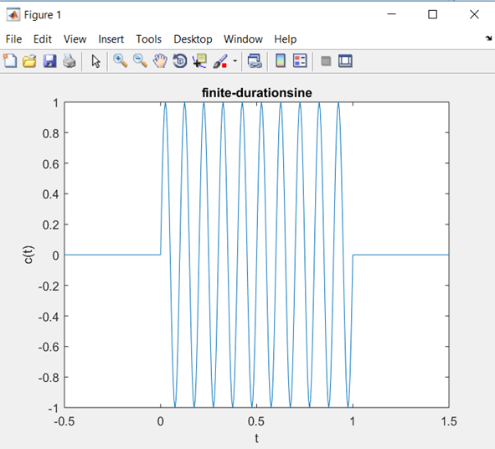
Solution a:
fc = 10;
t = -0.5:0.005:1.5;
c = sin(2*pi*fc*t).*rectpuls(t-1/2);
plot(t,c);
title('finite-duration sine');
xlabel('t');
ylabel('c(t)');

Slide 4
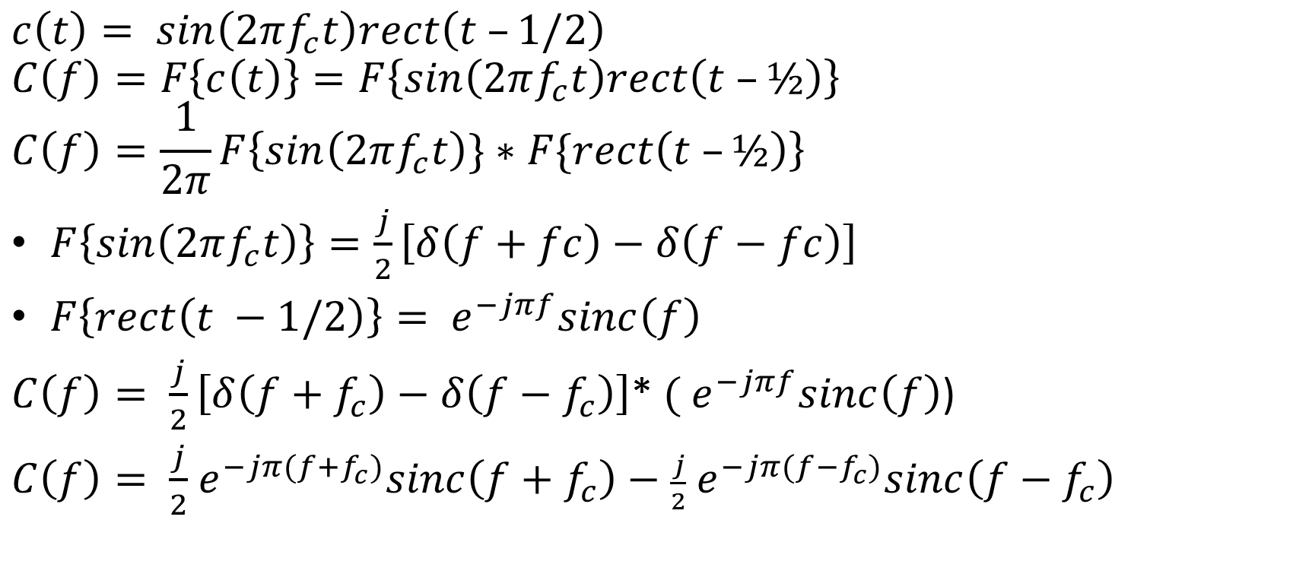
Fourier transform
$$c\left(t\right)= sin\left(2πf_{c}t\right)rect\left(t –1/2\right)$$
$$C\left(f\right)=F\left\{c\left(t\right)\right\}=F\left\{sin\left(2πf_{c}t\right)rect\left(t –½\right)\right\}$$
$$C\left(f\right)=\frac{1}{2π}F\left\{sin\left(2πf_{c}t\right)\}∗F\{rect\left(t –½\right)\right\}$$
$F\left\{sin\left(2πf_{c}t\right)\right\}=\frac{j}{2}\left[δ\left(f+fc\right)−δ\left(f−fc\right)\right]$
$F\left\{rect\left(t −1/2\right)\right\}={ e}^{−jπf}sinc\left(f\right)$
$C\left(f\right)= \frac{j}{2}\left[δ\left(f+f_{c}\right)−δ\left(f−f_{c}\right)\right]$* ${( e}^{−jπf}sinc\left(f\right)$)
$C\left(f\right)= \frac{j}{2}$ $e^{−jπ(f+f_{c})}sinc\left(f+f_{c}\right)−$ $\frac{j}{2}$ $e^{−jπ(f−f_{c})}sinc\left(f−f_{c}\right)$

Slide 5
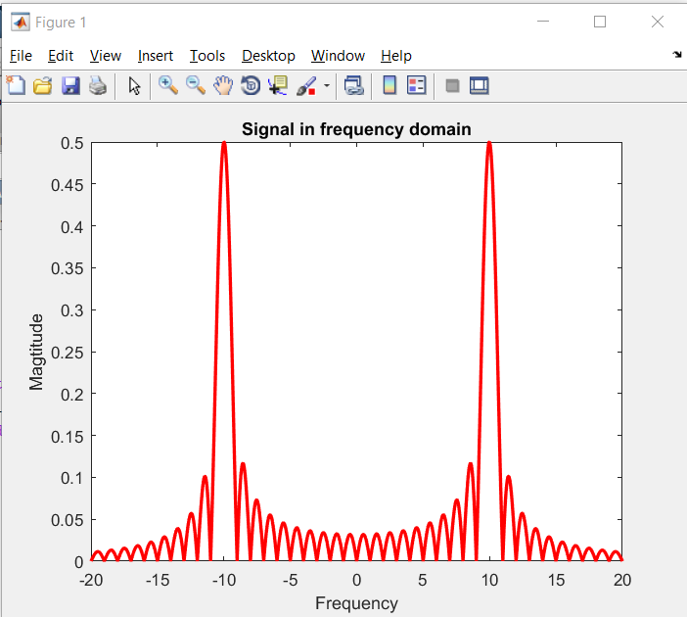
Solution b:
fc = 10;
t = -0.5:0.005:1.5;
f = -20:0.04:20;
c = 0.5*i*exp(-pi*i*(f+fc)).*sinc(f+fc) - 0.5*i*exp(-pi*i*(f-fc)).*sinc(f-fc);
plot(f,abs(c),'r-','linewidth',2);
xlabel('Frequency'); ylabel('Magtitude');
title('Signal in frequency domain');

Slide 6
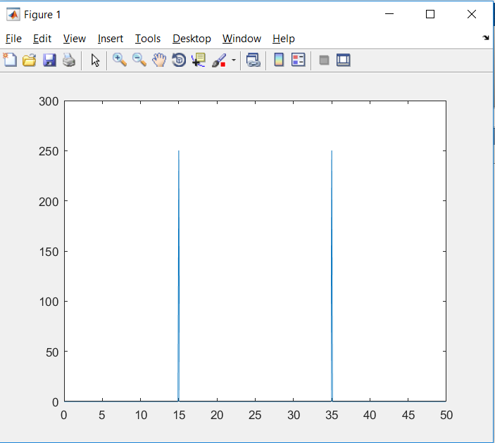
Solution c:
Frequency response of sine:
Bandwidth of sine signal is zero.
Bandwidth of c(t) is not zero.

Slide 7
2. Downconversion.
A signal x(t) is input to a mixer to produce the output y(t) where
y(t) = x(t) cos(ω0 t)
where ω0 = 2 π f0 and f0 = 5 kHz.
Using Fourier transform properties, derive an expression for Y(f) in terms of X(f).
Sketch Y(f) vs. f. Label all important points on the horizontal and vertical axes.
What operation would you apply to the signal y(t) in part (b) to obtain a baseband signal? The process of extracting the baseband signal from a bandpass signal is known as downconversion.

Slide 8
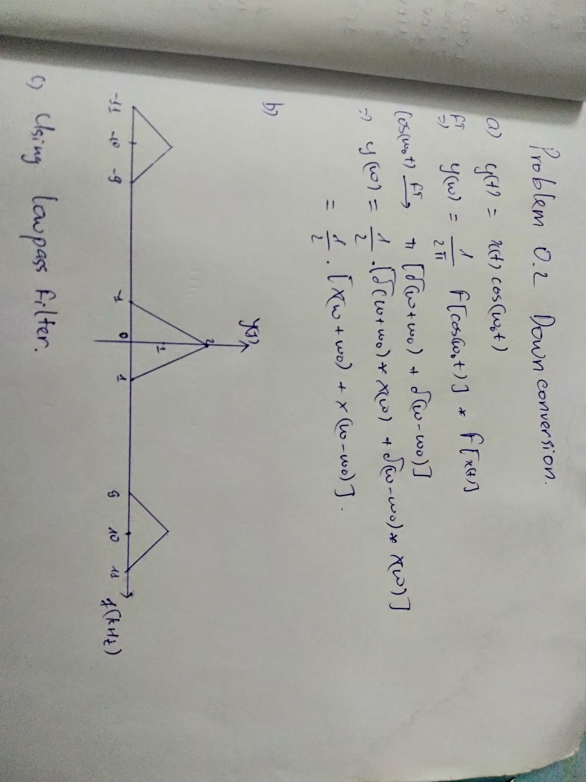
Solution 2:

Slide 9
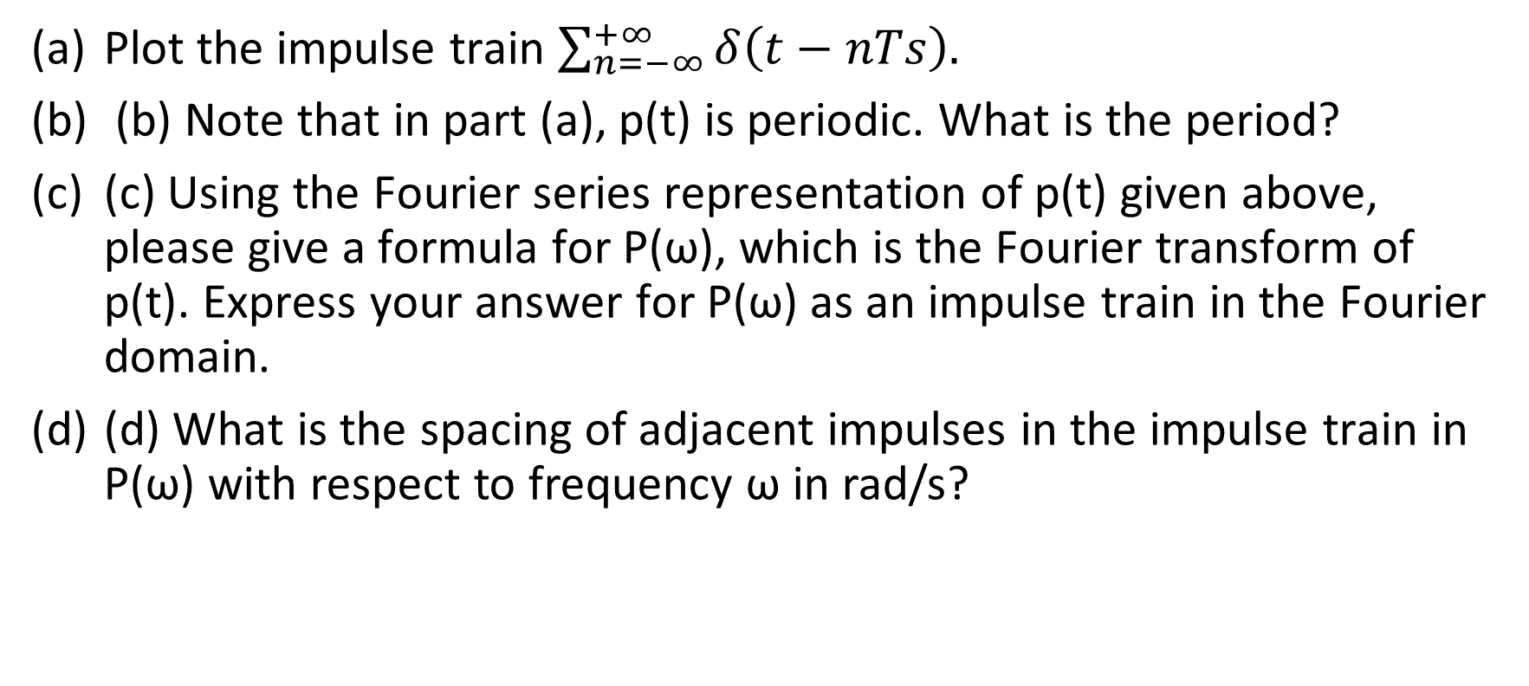
3. Sampling in Continuous Time.
Plot the impulse train $\sum_{n=−∞}^{+∞}{δ\left(t−nTs\right).}$
(b) Note that in part (a), p(t) is periodic. What is the period?
(c) Using the Fourier series representation of p(t) given above, please give a formula for P(ω), which is the Fourier transform of p(t). Express your answer for P(ω) as an impulse train in the Fourier domain.
(d) What is the spacing of adjacent impulses in the impulse train in P(ω) with respect to frequency ω in rad/s?

Slide 10
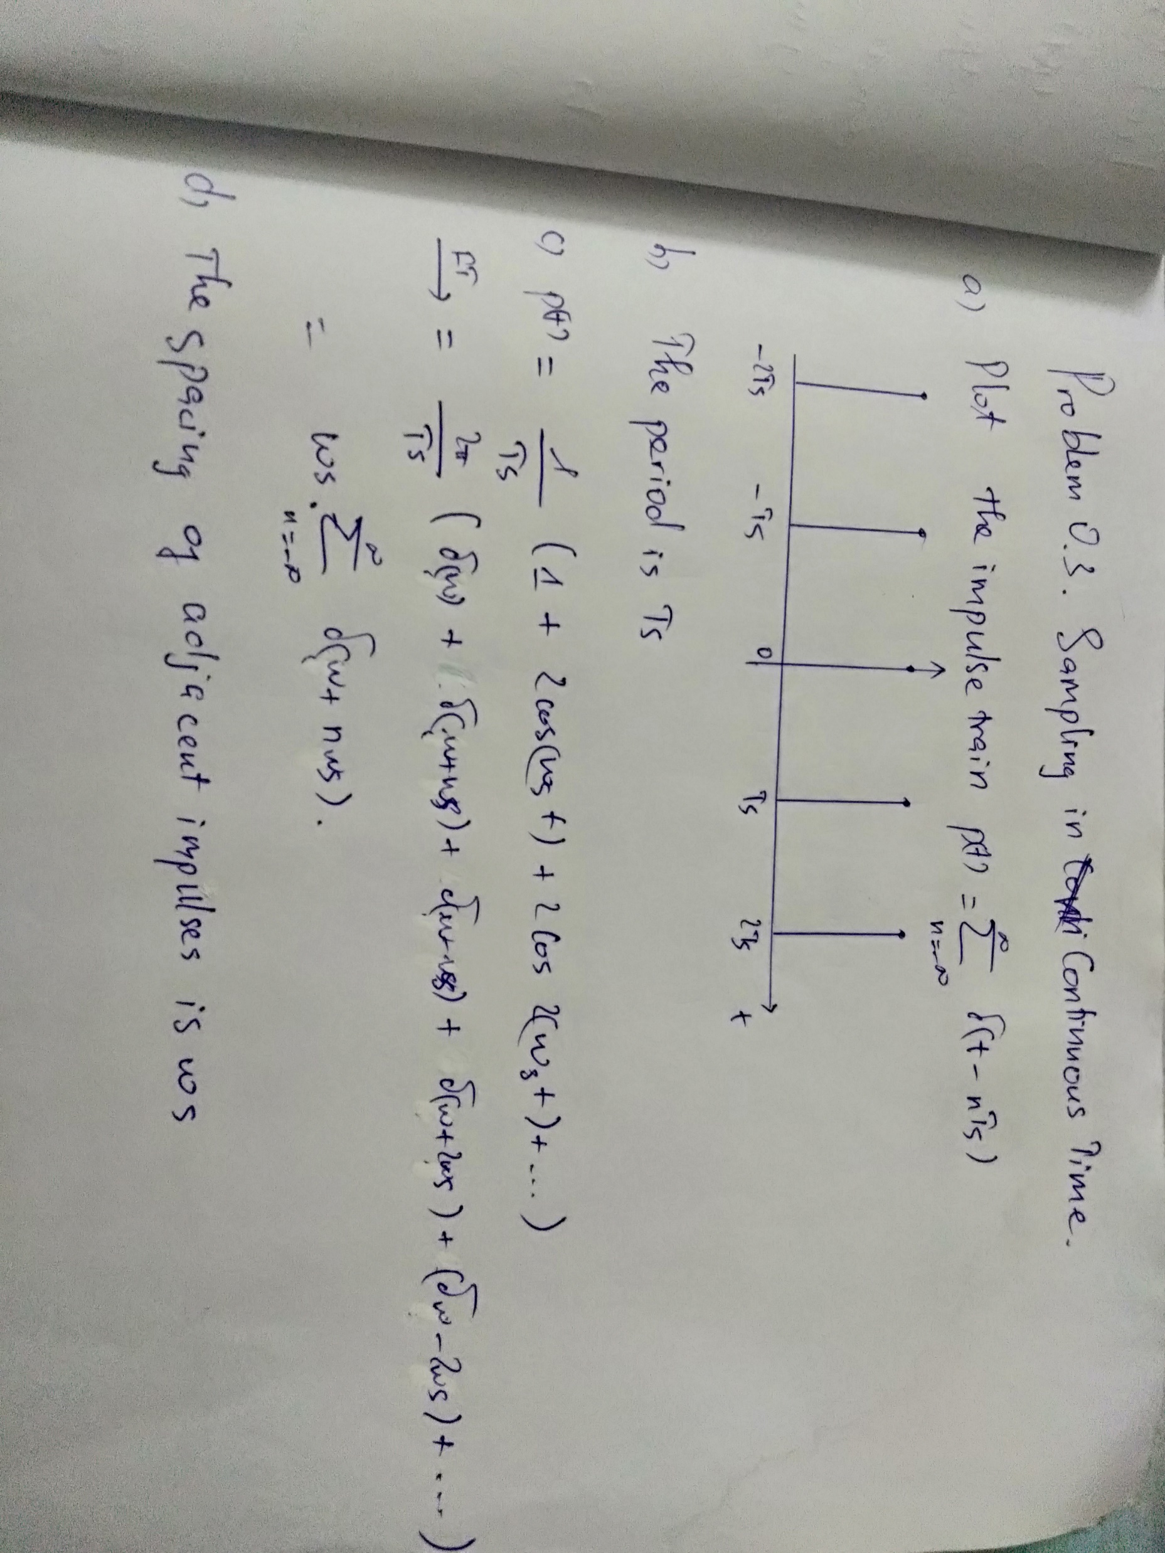
Solution 3:

Slide 11
4. Discrete-Time Sinusoidal Generation.
Consider a causal discrete-time linear time-invariant system with input x[n] and output y[n] being governed by the following difference equation: y[n] = (2 cos ω0) y[n-1] - y[n-2] + x[n] - (cos ω0) x[n-1]
Draw the block diagram for this system using add (or summation), multiplication (or gain), and delay blocks. Please label delay blocks with the text z -M to denote a delay of M samples. Use arrowheads to indicate direction of the flow of signals.
(b) Please state all initial conditions. Please give values for the initial conditions to satisfy the stated system properties.
. (c) Find transfer function equation in the z-domain, including the region of convergence.
(d) Compute the inverse z-transform of the transfer function in part (c) to find the impulse response of the system.
(e) Using MATLAB, LabVIEW Mathscript or Python, plot the impulse response obtained in part (d) for ω0 equal to 0, π, and a value in the interval (0, π) of your choosing. Turn in your code and plots.

Slide 12
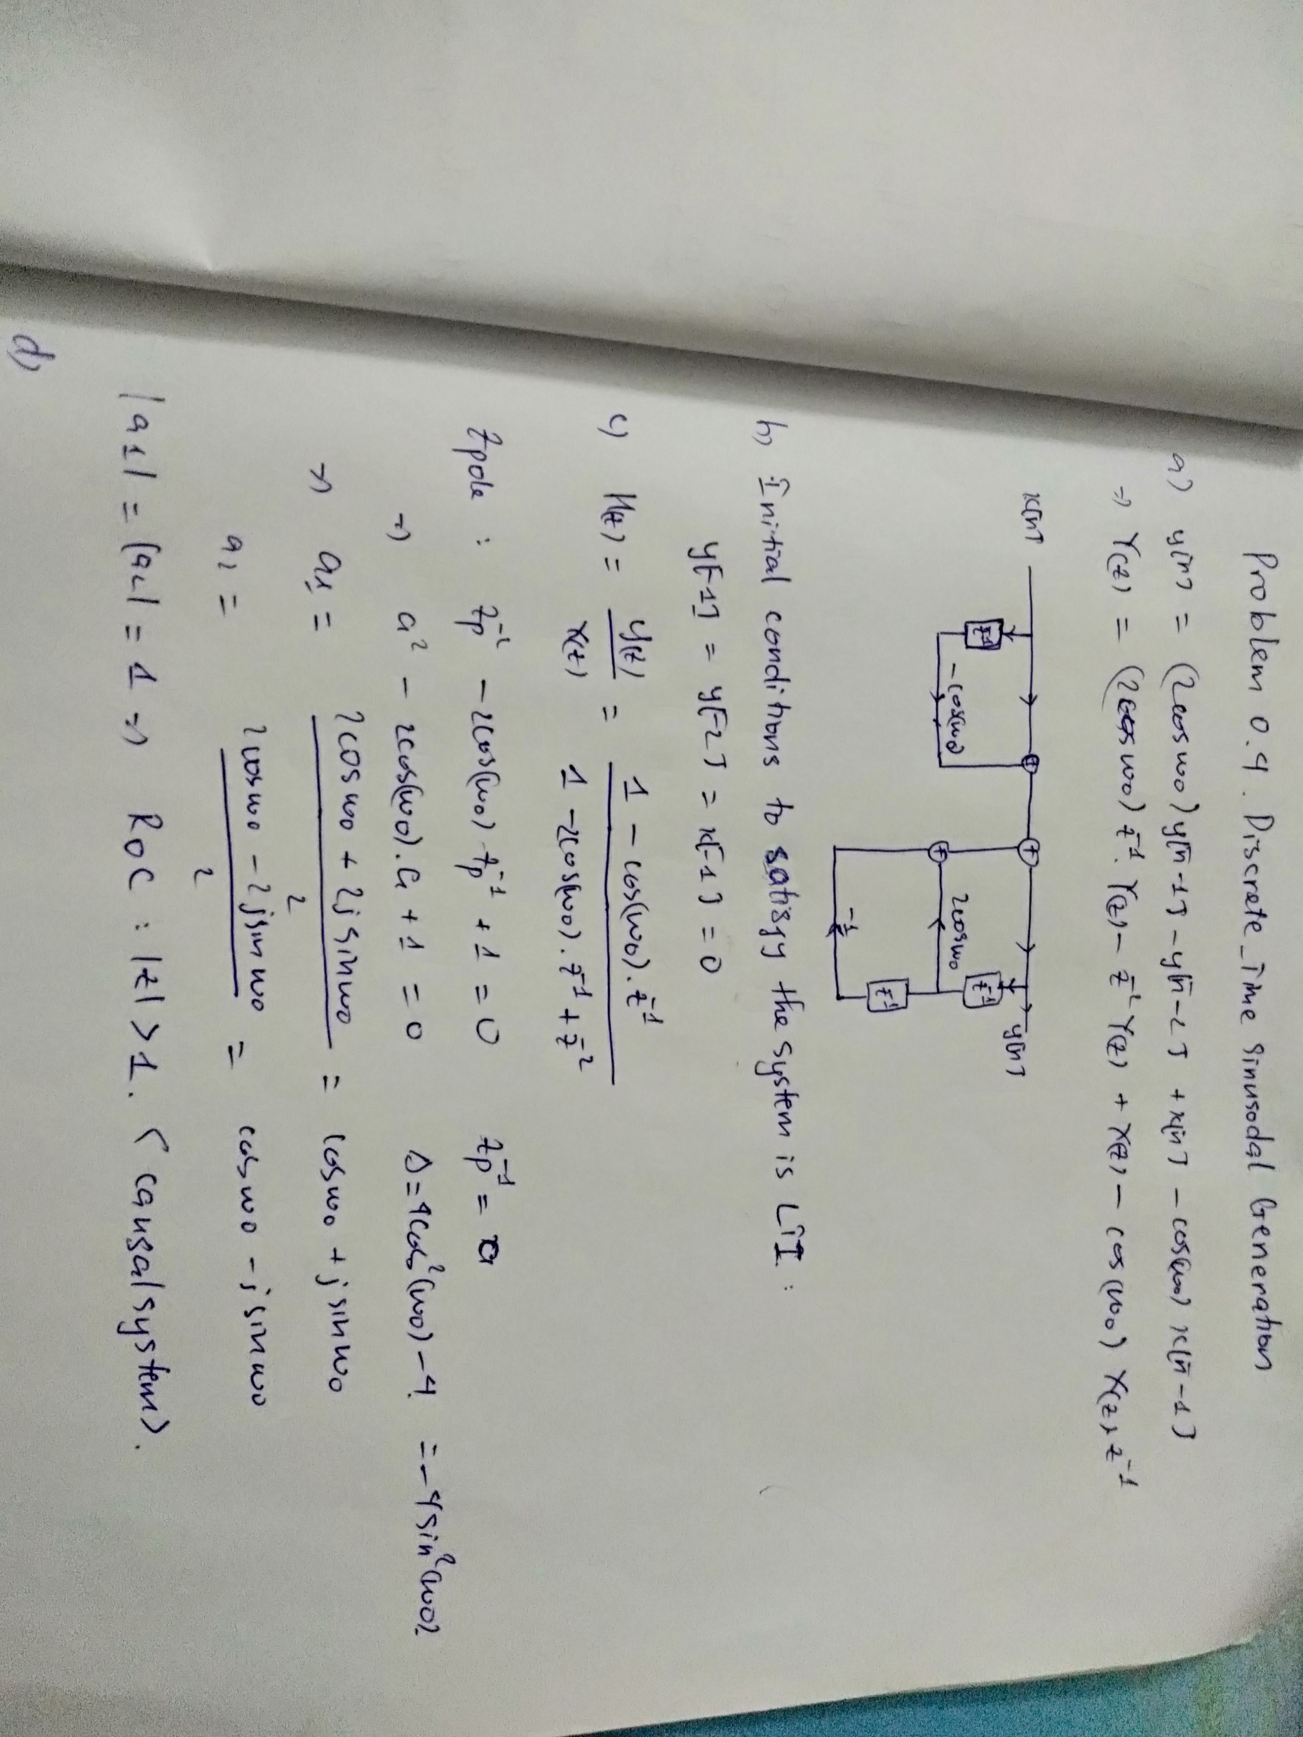
Solution 4:

